Slide 1
UNDERSTANDING TEACHER ATTRITION IN NEBRASKA:
A Quantitative Approach Using Markov Chains And Graph Theory
Name: Md Tahidul Islam
Department: Department of Mathematical and Statistical Sciences
University of Nebraska at Omaha
Kansas Mathematics Graduate Student Conference, May 2025
Notes:
Good afternoon, everyone.
My name is Md Tahidul Islam, and I’m a master’s student in Data Science in the Department of Mathematical and Statistical Sciences here at UNO.
Today I’ll be presenting my thesis, titled Understanding Teacher Attrition in Nebraska: A Quantitative Approach Using Markov Chains and Graph Theory.
This work was supervised by Dr. Mahbubul Majumder, with committee members Dr. Xiaoyue Cheng and Dr. Tami Williams.
Over the next 25-30 minutes I’ll walk you through the data, the modeling methods, our key findings, and a brief “what-if” policy simulation.
Let’s begin with an overview of why studying teacher attrition matters…”

Slide 2
Why study Teacher attrition ?
Keeping Great Teachers Where They Belong—In the Classroom.
Students Learn Better
Saves Money
Fairness for All
Plan Ahead
Better Decisions
Notes:
“Keeping great teachers in the classroom is our main goal. Here are five simple reasons why:
Students Learn Better
When teachers stay, students get consistent instruction and do better.
Saves Money
Every time a teacher leaves, schools pay to hire and train someone new.
Fairness for All
Turnover hits high-need schools hardest. Understanding who leaves helps us support those schools.
Better Decisions
Knowing why teachers leaves create smart policies—
Plan Ahead
By modeling how teachers move in and out, districts can predict staffing needs instead of scrambling when shortages hit.
As a rule of thumb I can say,.“Keep Great Teachers Where They Belong—in the Classroom.”
Next up is our agenda,

Slide 3
Agenda
Data Overview
Research Goals
Methods
Results
What-If Scenario
Notes:
, here’s our roadmap for today’s talk:
Data Overview
– I’ll begin by walking through the NE department of education dataset, key variables, and summary demographics.
literature review
.,in this part we gonna talk about research has been conducted on educators transitions.
Research Goals
– Next, I’ll review the five questions guiding this analysis—from modeling transitions to simulating policy impacts.
Methods
– Then we’ll dive into the core techniques: discrete-time Markov chains for the transition model, and graph-theoretic tools for network insights.
Results
– I’ll share our main findings: transition matrices, tenure estimates, career hubs, and clustering patterns.
What-If Scenario
– We’ll wrap up the analysis by exploring a 20% retention improvement and its projected long-term effects.
Q & A
– Finally, I’ll open the floor for your questions.
Let’s start with the data.

Slide 4
Data Overview
1.Data Source:Nebraska department of education from1983-2021
2.Key Variables : ID,Data Year,District,Ethnicity,Gender,Position,Education
3.Data Size: 89946 Unique Educators
Gender | Percent (%)
Male | 23
Female | 77
Position | Percent (%)
Teacher | 68.76
ParaProfessionals | 19.74
Specialist | 5.65
Administrator | 2.34
Teacher leader | 1.27
Counselor | 0.88
Ethnicity | Percent (%)
White | 93.09
Black | 2.39
Hispanic | 3.20
Other | ~1.5
Notes:
Here’s the foundation for our analysis:
Source & Timeframe: Personnel records from the Nebraska Department of Education, spanning from 1983 to 2021.
Sample Size: After cleaning and de-duplication, about 90,000 unique educators.
Key Variables:
Identifier: Staff ID
Year & District
Demographics: Ethnicity, Gender
Position
Positions Tracked: Teacher, Counselor, Administrator, Specialist, Paraprofessional, Teacher Leader, plus a derived “Exit” category for those who leave the profession.
On the right
Demographic Snapshot:
Gender: 23% male, 77% female
Race/Ethnicity: 93% White, 3% each for Black and Hispanic, rest is others
With that context in place, let’s turn to the existing literature and review the key analytical methods used in teacher-attrition research.

Slide 5
Research Goal:
1.Model educator role transitions using Markov Chains
1
2.Evaluate long-term attrition and role distributions
2
3.Apply Graph Theory to characterize the structure of career mobility
3
4.Identify roles that influence systemic stability or vulnerability.
4
5.Simulate policy interventions on exit rates
5
Notes:
We structured our work around five specific objectives.
Model educator role transitions using Markov Chains
Estimating annual transition probabilities between all roles (including exit).
making precise measurement with discrete-time Markov chain on the cleaned NDE data.
Evaluate long-term attrition and role distributions
Computing the chain’s steady-state distribution to see where educators settle over many years.
Computed average tenure estimates by role .
Apply Graph Theory to characterize career mobility
Construct a directed, weighted network from the transition matrix.
Analyze centrality (e.g., PageRank) and community structure to reveal key mobility patterns.
Identify roles that influence systemic stability or vulnerability
Using network-based measures (e.g., vulnerability indices) to pinpoint roles critical to overall retention.
Highlight positions whose removal or high exit rates would most destabilize the system.
Simulate policy interventions on exit rates
Modeling a hypothetical 20% reduction in exit probabilities across roles.
Forecast impacts on long-run retention, role distributions, and network resilience.
Next, we’ll step through Goal 1—building and validating our Markov‐chain transition model.

Slide 6
Markov Chain Modeling
Estimating Annual Role-to-Role Transition Probabilities
Notes:
Now that we’ve covered our goals and overall approach, let’s move into the first method: Markov chain modeling. On this slide ,we’ll unpack exactly what a Markov chain is and how it fits our data.

Slide 7
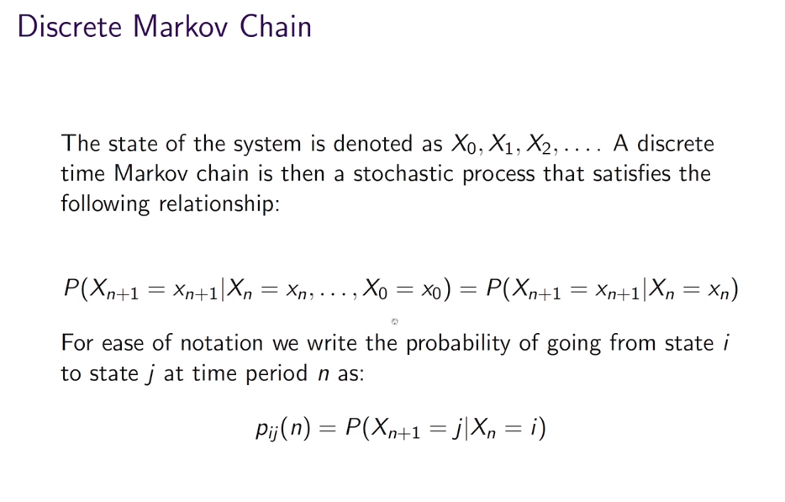
Markov Chain
Markov Property: The state of the system at time n+1 depends only on the state of the system at time n
X₁
X₂
X₃
X₄
X₅
Notes:
Let’s now turn to the heart of our transition model: the Markov chain.
Next year’s role depends only on this year’s role—nothing before that.
Markov Property
“The state of the system at time n+1 depends only on the state at time n.”
In our context: if someone is a Teacher this year, their chances of staying Teacher, moving to another role, or exiting depend just on “Teacher” today.
(Pointing out the formula)
Explain: “All we need is the one‐step conditional probability—no history beyond the current state.”
We call Pij is the probability of moving from state i to state j in one year. In practice, we’ll estimate these directly from the NDE data.
Next, we will show how markov chain works with a scenario.

Slide 8
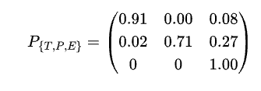
Understanding Markov Chain with a Scenario
"An educator is a Paraprofessionals this year. What happens next year ?"
71% stay as Paraprofessionals
2% stay as Teacher
27% will Exit
"An educator is a Teacher this year.
What happens next year ?"
91% stay as Teacher
8% will exit
~1% moves on another Role
Notes:
Let’s make those transition probabilities concrete with two simple examples.
Paraprofessional Scenario (left box):
“Imagine an educator is a Paraprofessional this year. What happens next year?”
71% will remain Paraprofessionals.
2% will move into a Teacher position.
27% will exit the profession.
Teacher Scenario (right box):
“Now imagine an educator is a Teacher this year. Next year…”
91% stay as Teachers.
8% exit the profession.
~1% move into another role (Counselor, Leader, etc.).
“These two snapshots illustrate how to read any row of our transition matrix: pick the current role, then see the percentages of where educators end up a year later. Next, we’ll look at the matrix and network flow

Slide 9
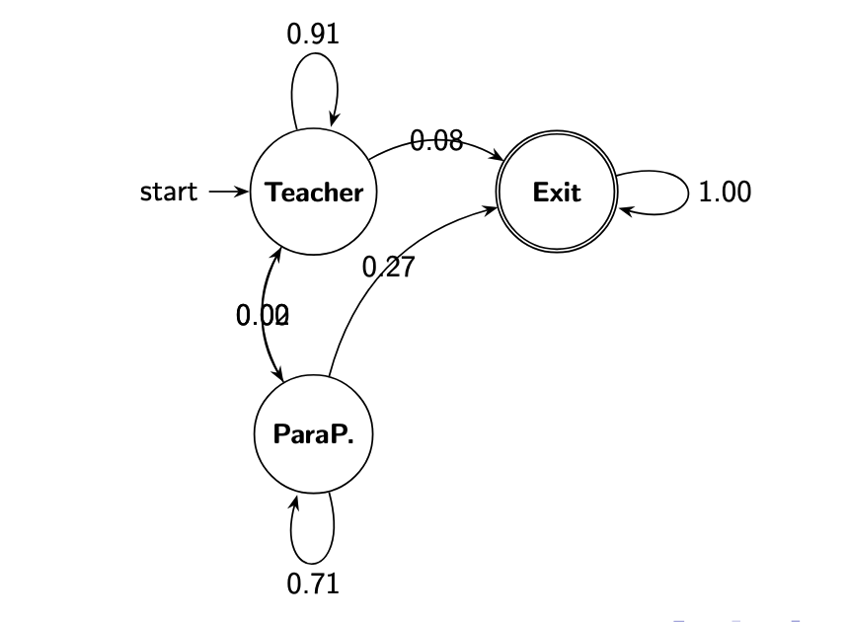
Markov Process
Key Idea: Next-year role depends on the Current role (memoryless), via these ''transition'' probabilities
0.02
Notes:
Here we see a tiny version of our full model,which Is also a senario from the previous slides—with just three states: Teacher (T), Paraprofessional (P), and Exit (E).
(point out the right plot)
From Teacher → Teacher, the arrow is labeled 0.91, so 91% of teachers stay teachers next year.
From Teacher → Exit, 0.08 means 8% leave.
From Teacher → ParaP, 0.02 means 2% move to paraprofessional.
Likewise, Paraprofessional → Paraprofessional is 0.71 (71% stay), and P → Exit is 0.27 (27% leave).
The Exit → Exit arrow is 1.00, since once someone leaves, they remain out of the system in our model.
(point out the matrix on the left)
Rows are “where you start” (current role).
Columns are “where you end up” next year.
For example, reading the second row tells us: if we start as a Paraprofessional, we have a 2% chance of becoming a Teacher, 71% chance of staying Paraprofessional, and 27% chance of exiting.
Key Point:
These two boxes (or any row of this matrix) show exactly how to read our transition data: pick your current role, then read across to see your next-year chances.
Next, we’ll scale this idea up to all seven roles ,visualizing a heatmap with full transition matrix and then explore what happens if we project these transitions forward over many years in couple of slides

Slide 10
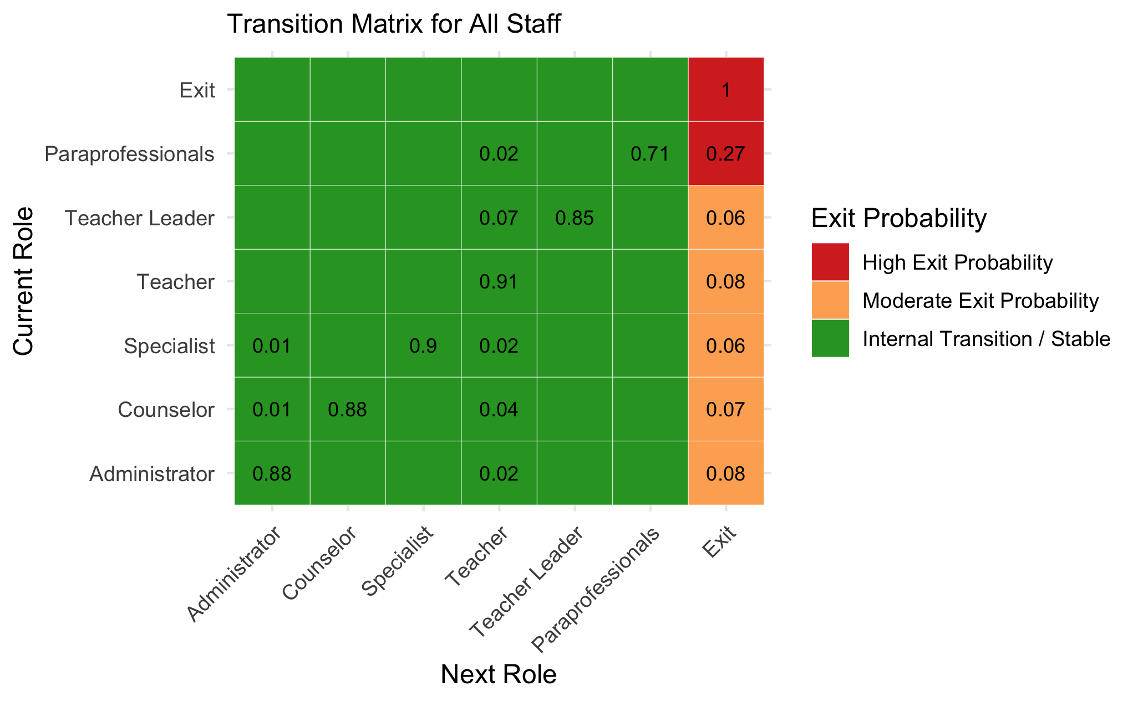
All Educators Transition Probability for Next Year
Row: Current Role, Column: Next Role
Notes:
“Here we’ve highlighted the Teacher row and the Exit column. You can see that 27% of paraprofessionals leave the profession each year—the highest exit rate of any role—while only 2% move up into teaching and 71% stay .This suggests a critical need for better support and career‐advancement pathways at the paraprofessional level to curb turnover and strengthen our educator pipeline.

Slide 11
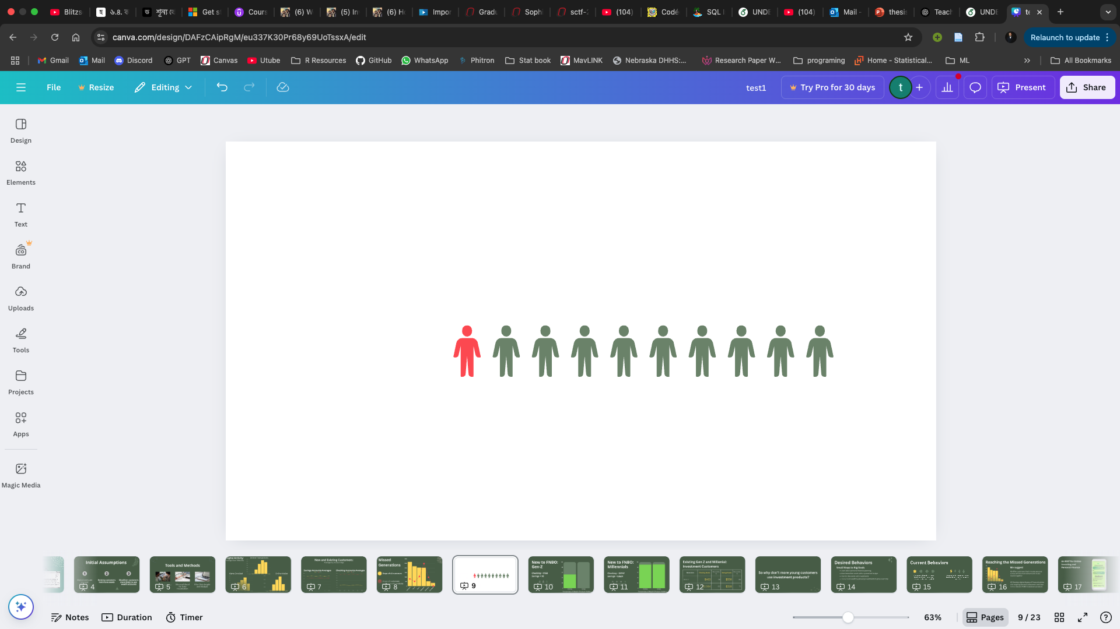
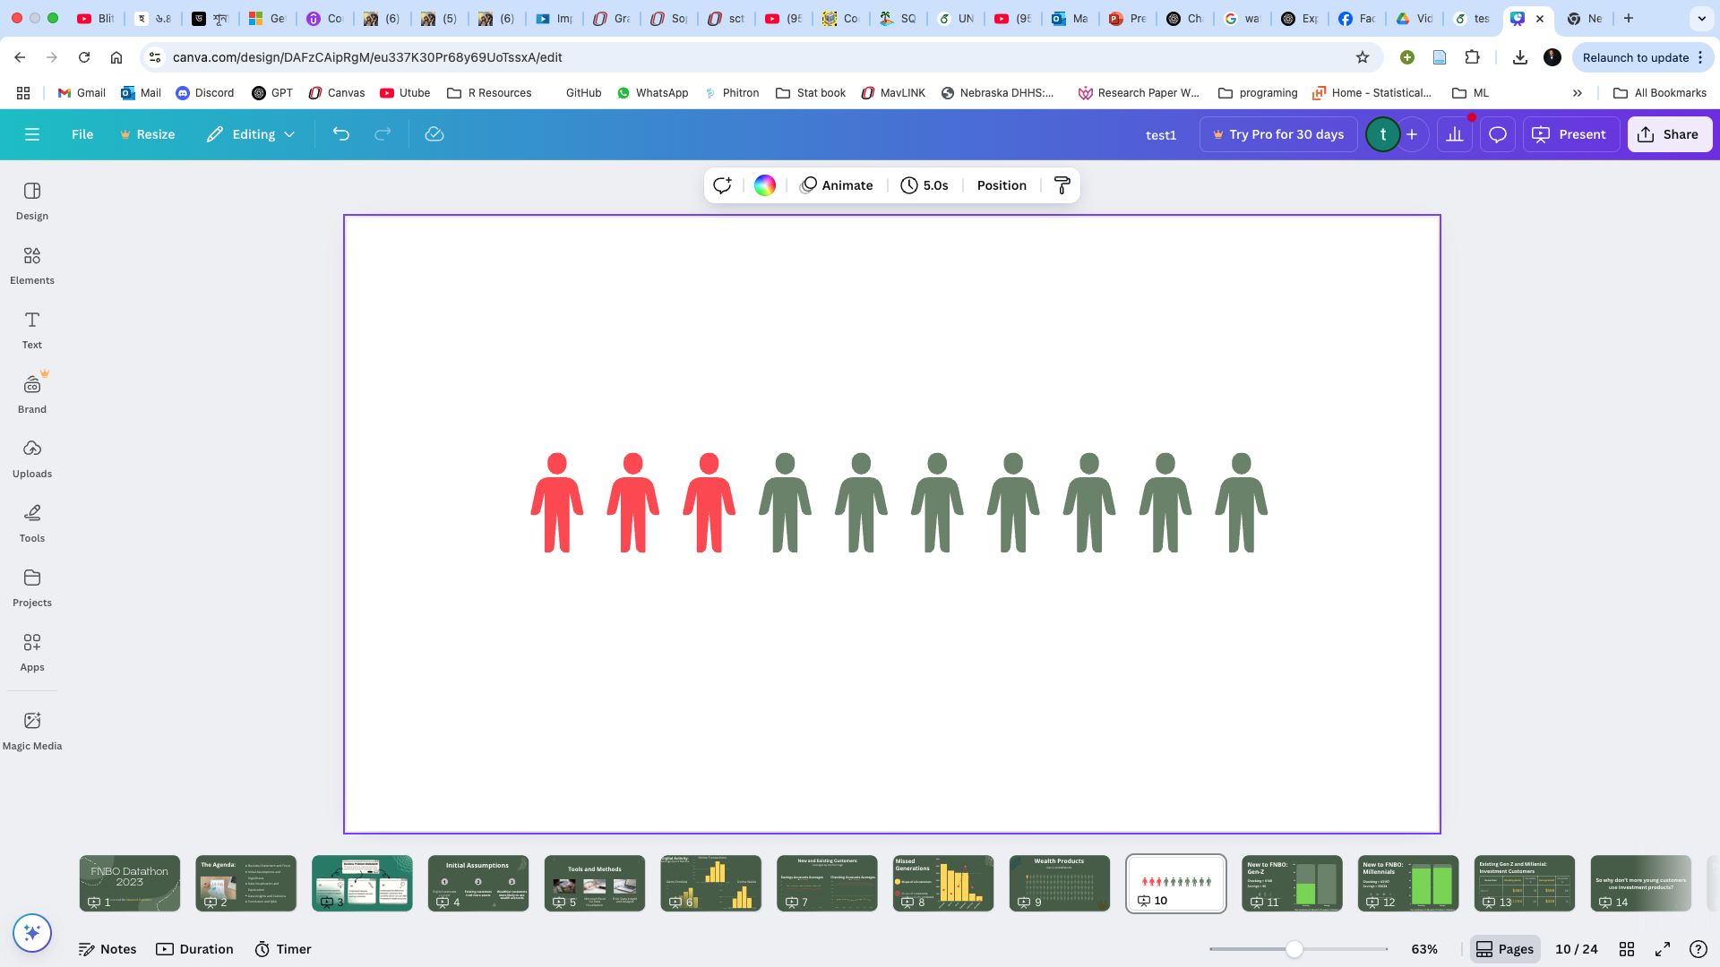
Out of every 10 Teacher, roughly 1 leaves the profession each year.
Out of every 10 paraprofessionals, roughly 3 leaves the profession each year.
Notes:
Building on the 27% exit rate we saw in the heatmap, this slide shows it simply: out of every 10 paraprofessionals, roughly 3 leave each year (red icons) and 7 stay (green icons). It’s a clear way to see how high turnover really is—and why we need targeted retention efforts in these roles.
Next, we’ll drill down further into paraprofessional turnover—looking at exit rates by gender and ethnicity—to pinpoint which groups are most at risk and where support could make the biggest difference.

Slide 12
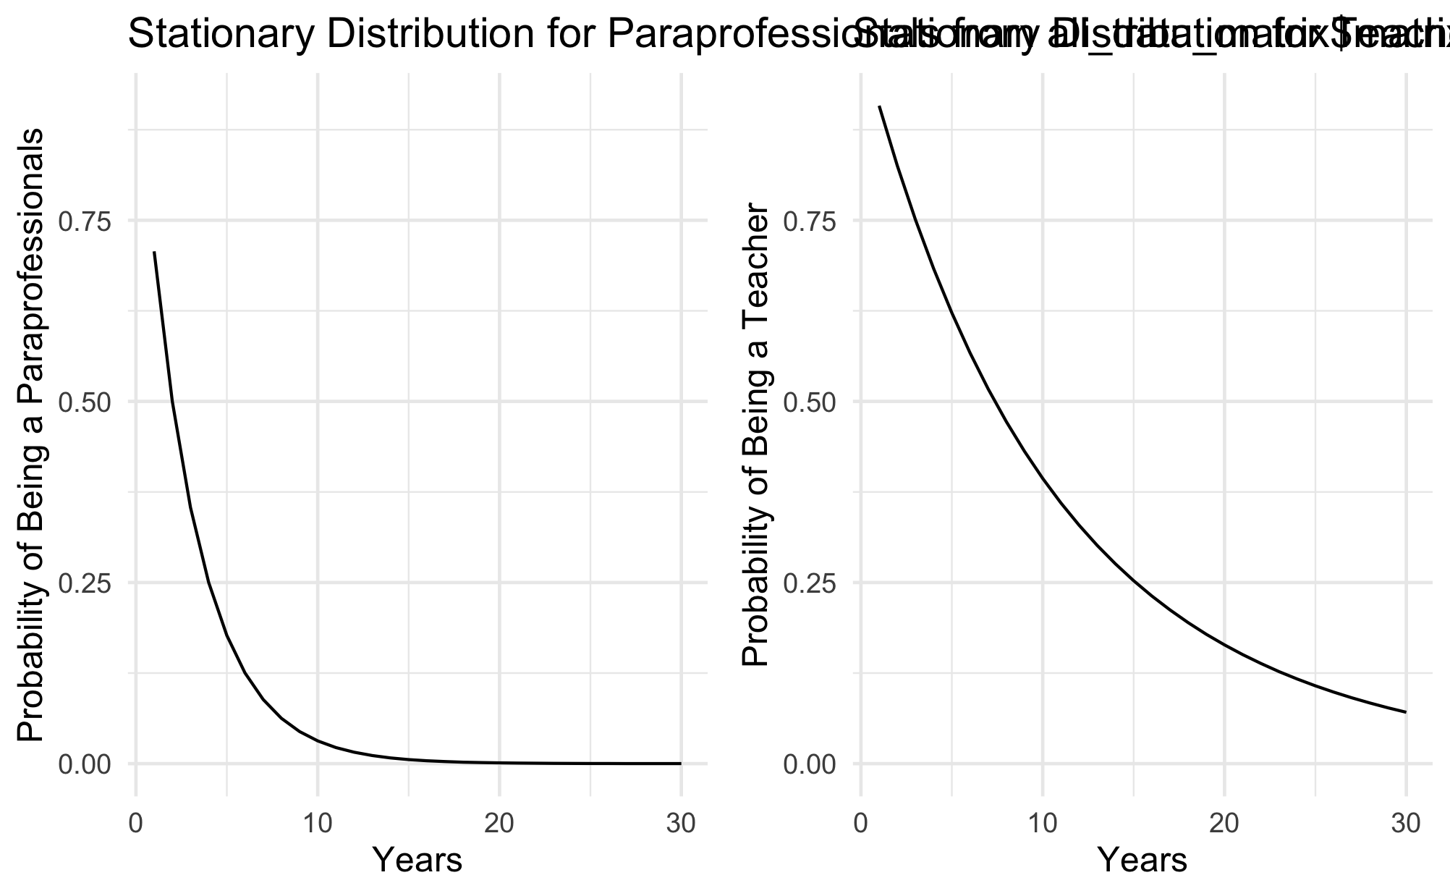
How Paraprofessionals and Teachers Settle Into Roles Over Time
Left panel shows paraprofessionals; right shows teachers
Notes:
“Here we’re looking at the chance of still being in the same job as years go by:
Paraprofessionals (left): The line plunges quickly—by year 5 only about 20% remain, and by year 10 almost none are still in that role.
Teachers (right): The line falls much more slowly—around half of teachers are still teaching after 10 years.
Other roles: When we plot counselors, administrators, specialists, and teacher leaders, their curves fall at a pace similar to teachers—far more gradual than paraprofessionals.
This makes it clear that paraprofessionals leave at a much faster rate than virtually every other role, underscoring the need to focus retention efforts on that group.”
In the next slide we gonna computed average of any roles to stay in the system.

Slide 13
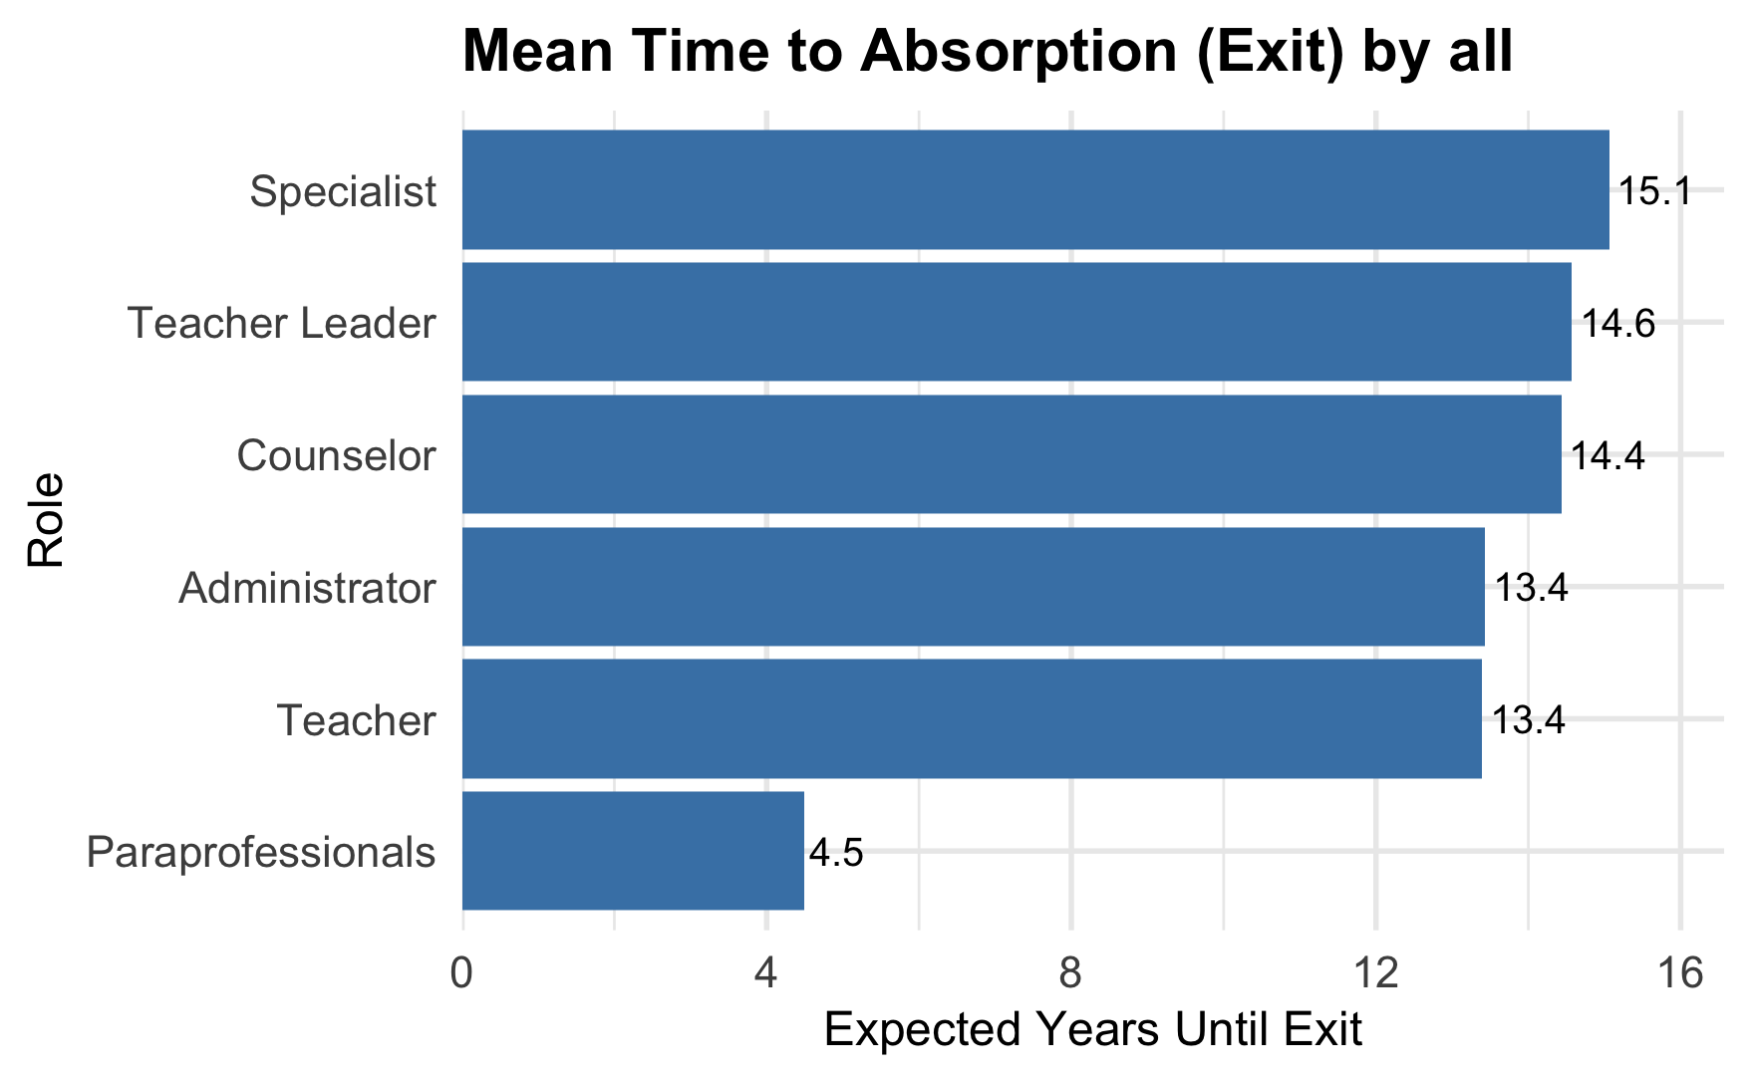
Average Time in Role Until Exit
Notes:
These numbers come directly from our Markov model’s calculation of average time-to-exit (mean time to absorption). In plain terms, it tells us how many years someone in each role will stay before exiting. Paraprofessionals average about 4½ years in their role before leaving, whereas teachers, counselors, specialists, and leaders each average around 13–15 years—a threefold difference that really underscores where our retention efforts should focus.
In the next slide I am dig upon and look for any significant changes based on demographics

Slide 14
Career Network Analysis Graph-Theoretic Exploration of Educator Flows

Slide 15
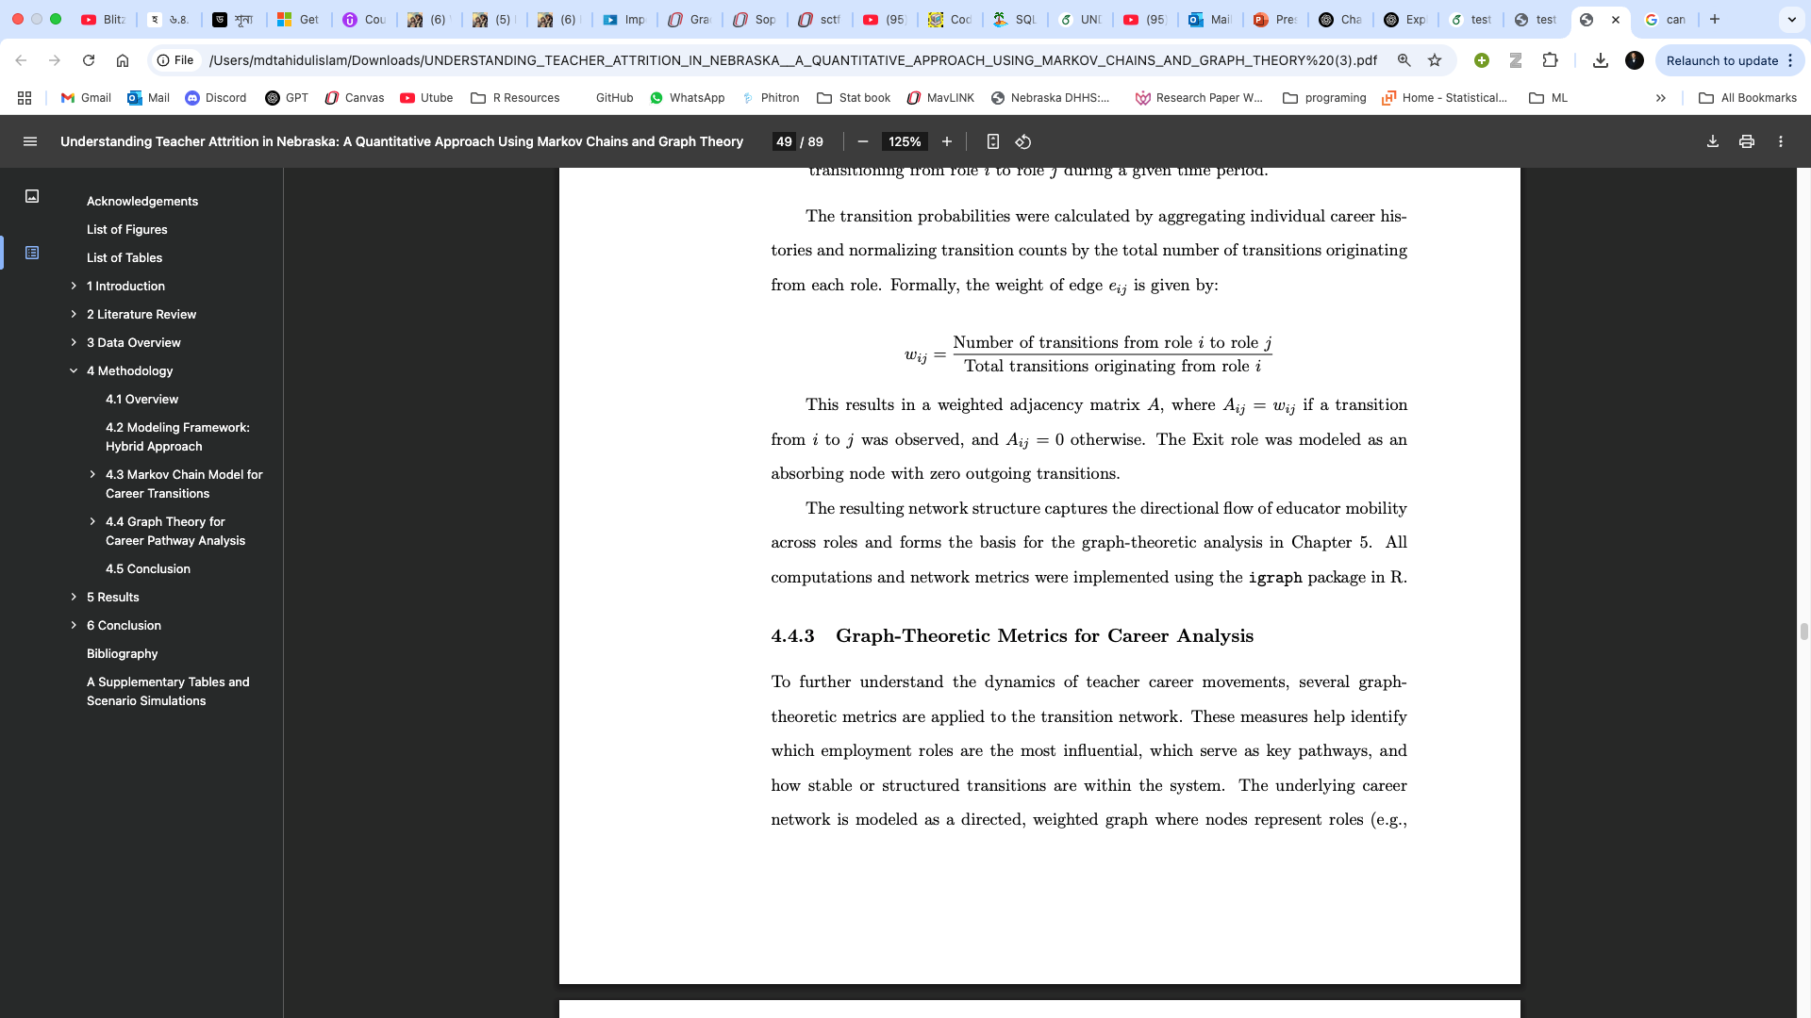
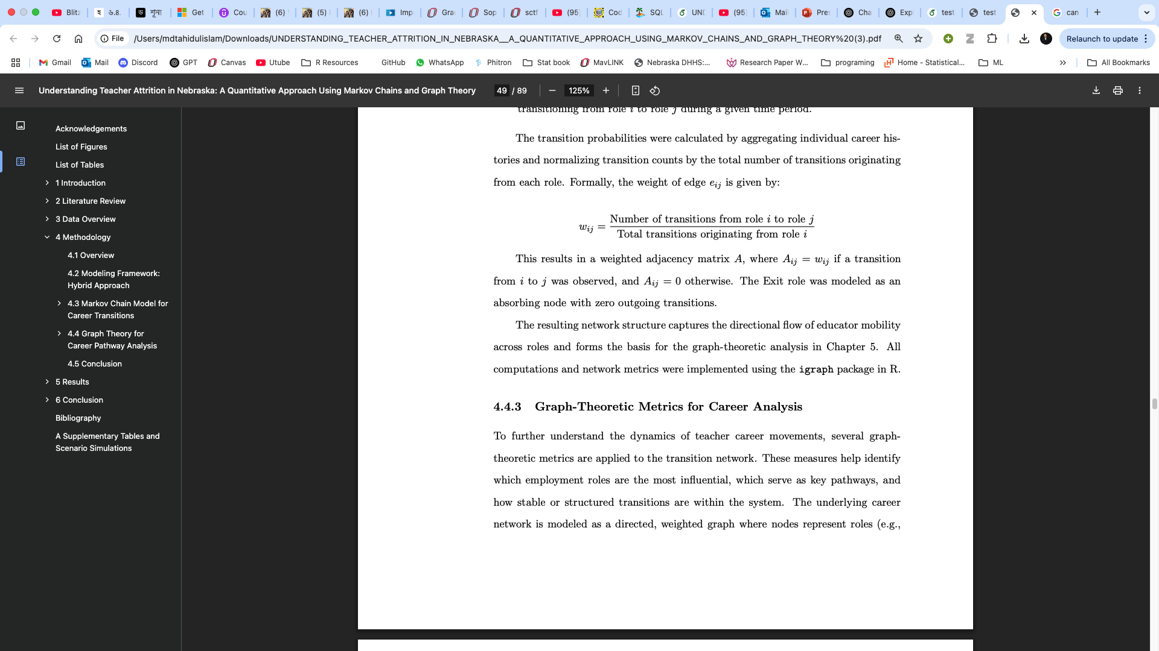
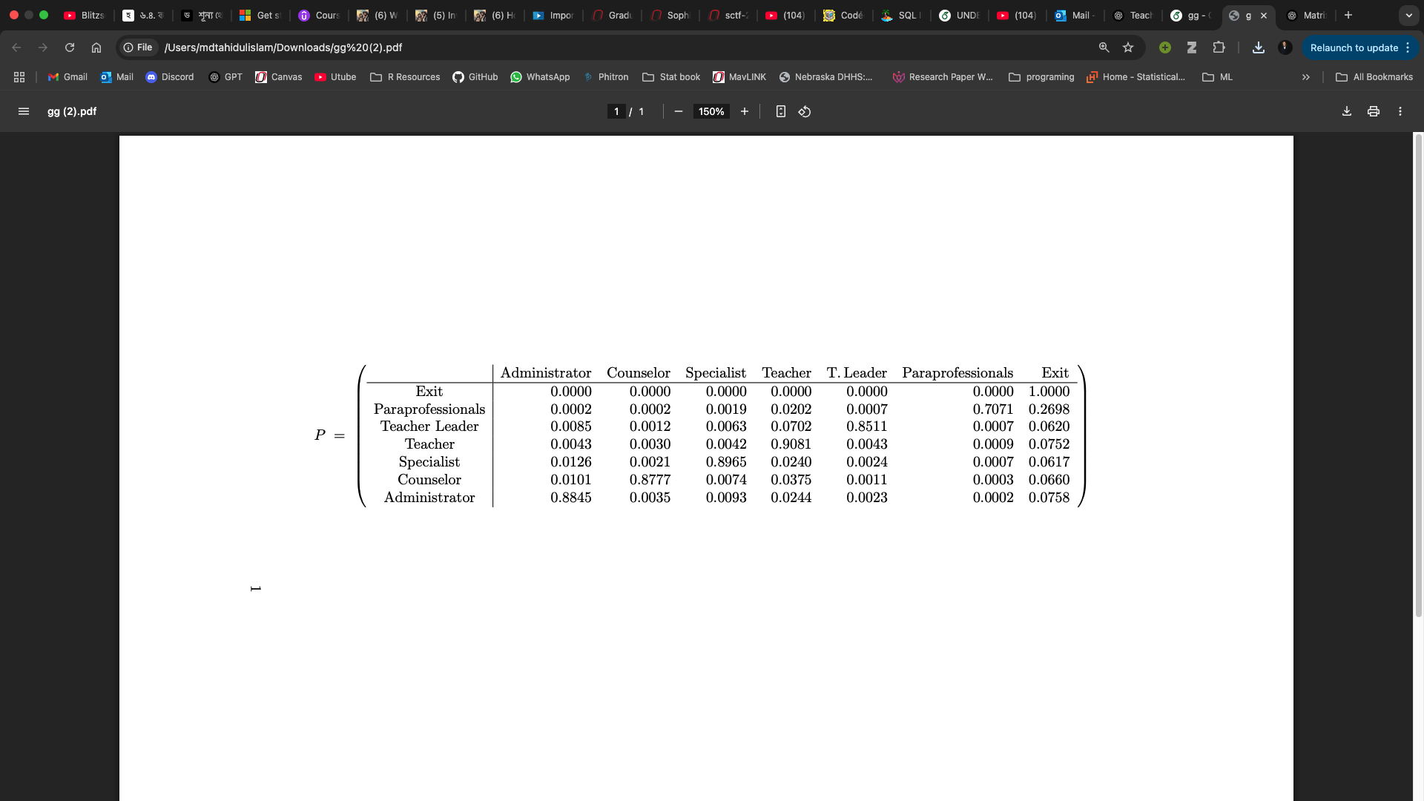
Network Construction with Graph Theory
Weight of edge,
Notes:
Now we turn our year-to-year probabilities into a simple career map.
Roles as Dots
“Each job title—Teacher, Counselor, Administrator, Paraprofessional, and Exit—is a dot on our map.”
Moves as Arrows
“We draw an arrow whenever some educators switch from one role to another in a year. The thicker the arrow, the more common that move.”
How We Measure Thickness
“Take the number of people who went from Role A to Role B in one year, then divide by the total who started in Role A. That fraction is the arrow’s thickness.”
By putting all those together we gonna construct out network maps after few slides with results.
Putting It in a Table
“We collect all those fractions into a table (the transition matrix). Each row adds to 1,
Why This Helps
“From this Transition matrix,I am gonna transtion probabilities and .couple of of other calculations for results.”
“Up next: an example scenario to make this concrete.”

Slide 16
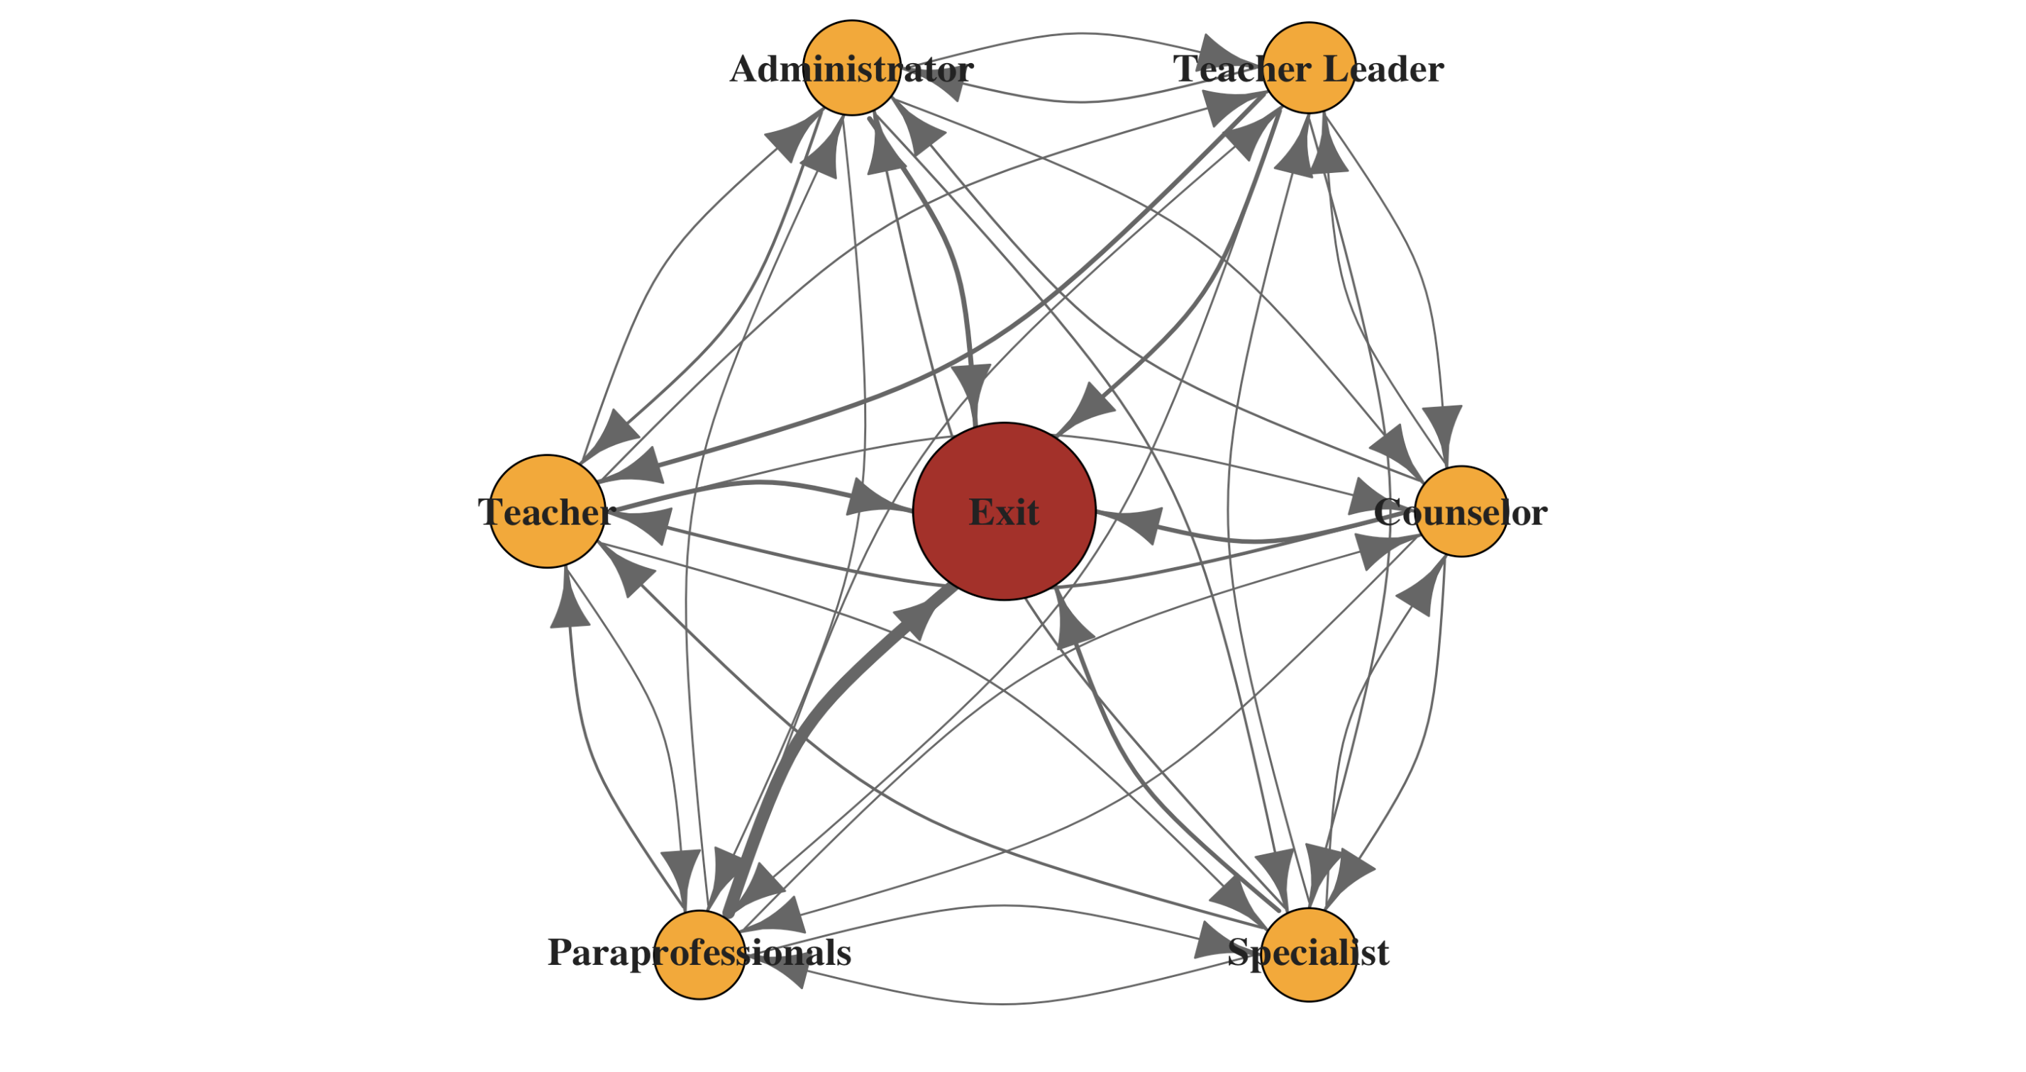
One-Year Career Flow Network for Educators
Notes:
“This network shows all one-year moves between roles: each circle is a role (with Exit in red), and each arrow represents the flow of educators from one role to another.
Arrow thickness reflects how common the move is—notice the thick arrow from Paraprofessionals to Exit, highlighting that high-volume churn.
Dense connections around the circle show stable, lateral moves (e.g., between Teacher and Specialist).
Exit is central, pulling significant flows from every role, but especially from Paraprofessionals.
“Next, we’ll trim this network to show only the strongest career pathways for a clearer view of key transitions.”

Slide 17
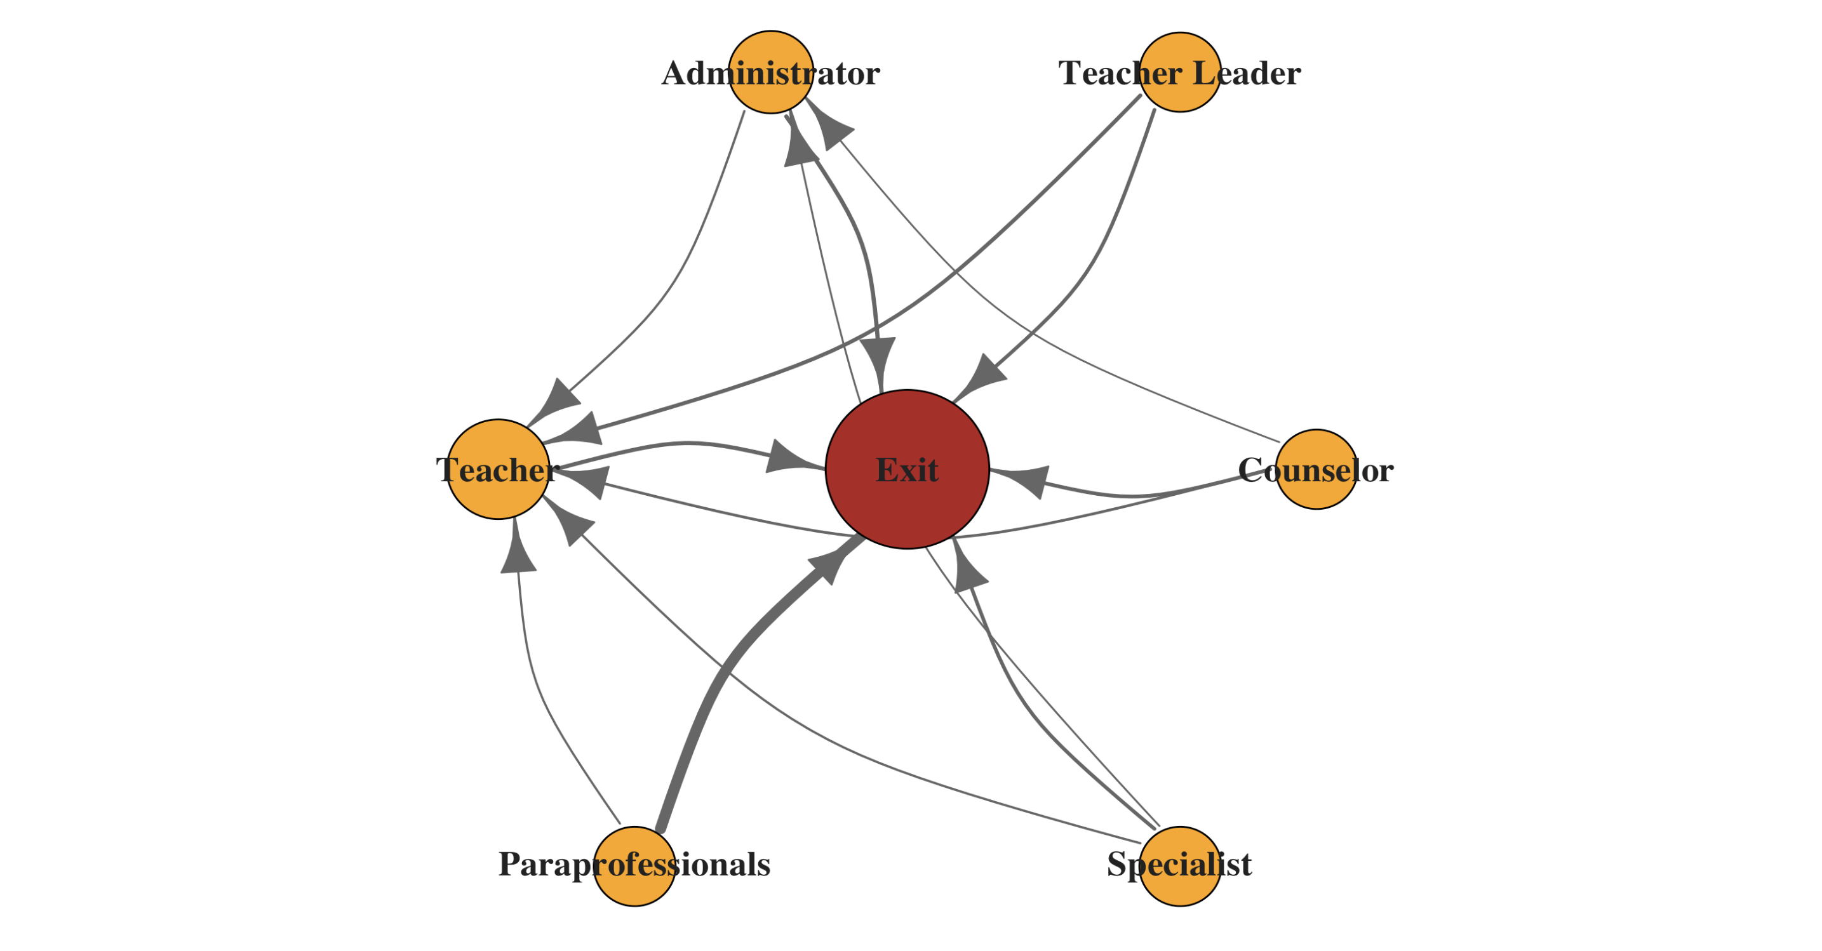
Core Career Flows (only ≥2% transitions shown)
Notes:
“Here we’ve trimmed the network to show only the most common moves—those that happen at least 2% of the time.
Paraprofessionals to Exit stands out as the single largest flow (thickest arrow), reinforcing that over a quarter leave each year.
all other roles to Teacher, showing those roles trade people regularly.
Specialist → Teacher/Administrator and Counselor → Teacher/Administrator are the main lateral moves into the classroom.
On 2% level there is no movements on teacher leader and counselor roles..,
“By focusing on these core flows, we can see exactly where to intervene—strengthening support for paraprofessionals and smoothing key career ladders into teaching and leadership.”
In the next slide I am going to talk about which postion is a common path for career movements

Slide 18
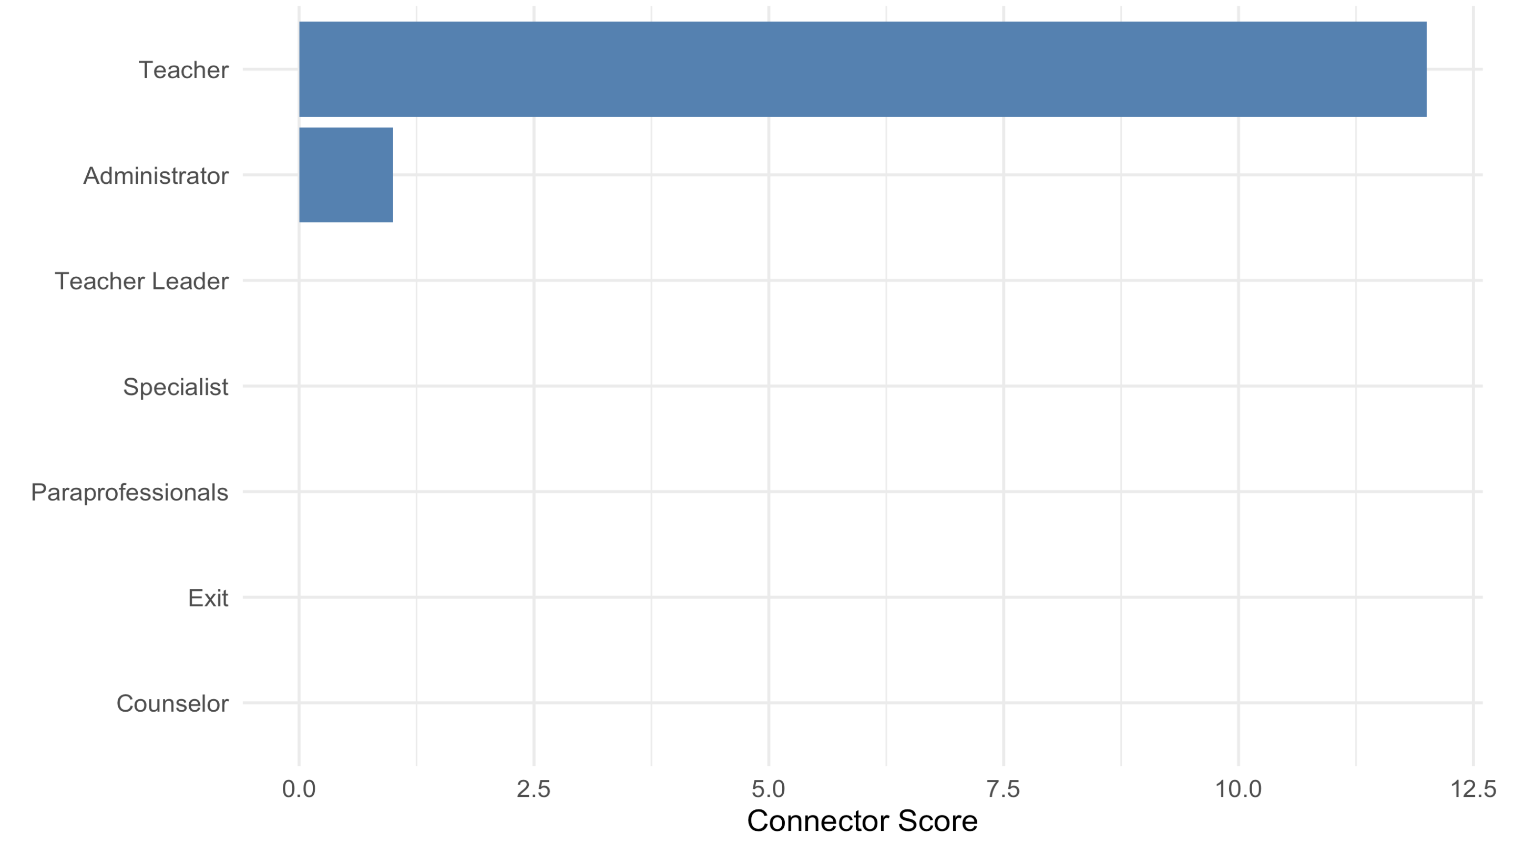
Which Roles Serve as Career Hubs?
Notes:
“Think of each role like a busy train station and our ‘connector score’ as the number of trains (career moves) that go through it.
Teachers are the busiest station by far—most educators either start, end, or pass through the teaching role.
Administrators are the next-biggest hub, but far behind teachers.
Other roles like paraprofessionals, counselors, and specialists see only a handful of ‘stopovers.’
“This tells us that strengthening support for teachers—and making clear paths into administration—will have the biggest impact on the entire educator network.”
`
In the next slide I am going to talk about landing probability of any roles.

Slide 19
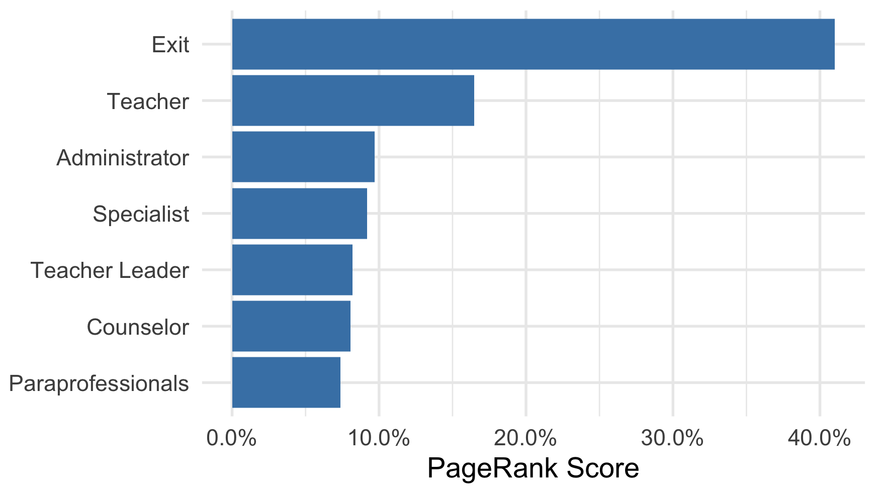
Where Do Educators End Up? (Landing Probabilities)
Notes:
“This bar chart shows the long-run “landing probability” for each role—that is, if you randomly follow year-to-year moves over many cycles, where do you most often pop out?
Exit (42%) stands out: in the steady state, about four in ten educators will find themselves exiting at any given step.
Teacher (22%) is the next most likely landing spot—nearly one in five “stays” or returns to the classroom over time.
Administrator, Specialist, Teacher Leader, Counselor, Paraprofessional each hover around 7–10%, meaning they play smaller but still important roles in career paths.
Key takeaway:
Even after dozens of transitions, exiting the profession remains the single most common outcome. stronger supports to keep educators in the system—and especially in teaching roles—could shift that balance significantly.
In the next I am going to talk about carrer buddies: Who hang out with whom ?

Slide 20
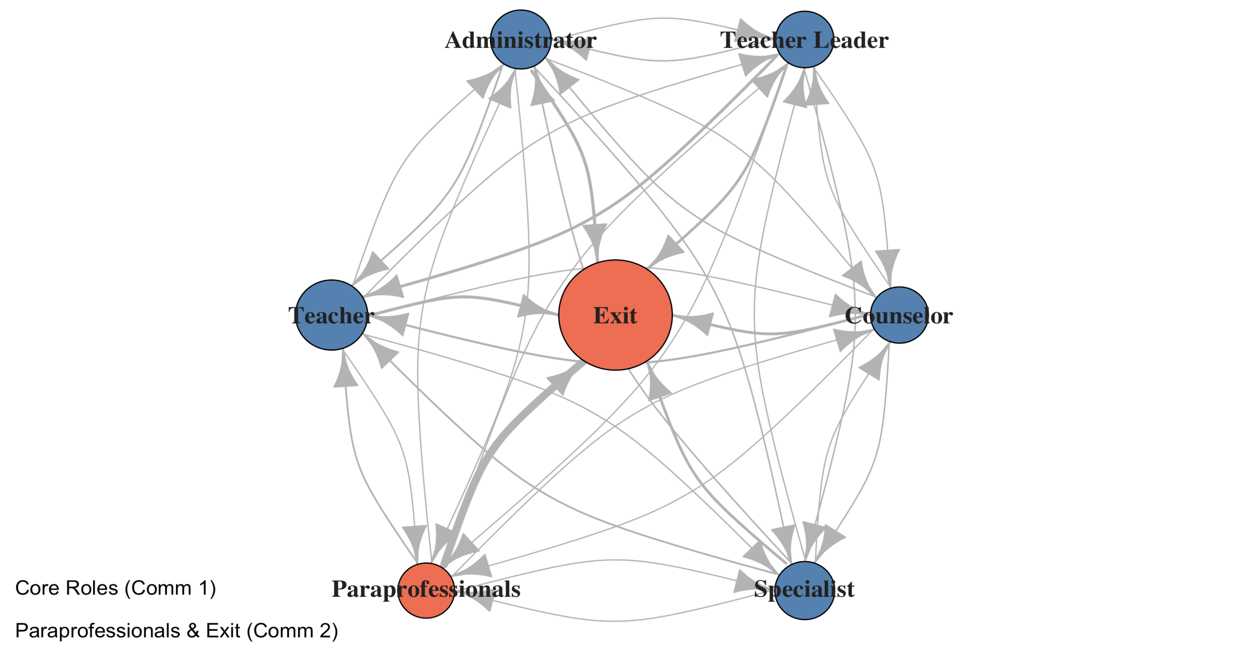
Career Buddies: Clustering Educator Role Transitions
Notes:
Here we ran a community-detection algorithm—think of it as a ‘buddy system’—to see which roles stick together.
The blue group (Teacher, Specialist, Counselor, Teacher Leader, Administrator) forms a tight circle where educators frequently move between these instructional and leadership roles.
The red group (Paraprofessionals and Exit) stands apart, showing that paraprofessionals mostly transition toward leaving rather than into other school roles.
“This ‘buddy system’ highlights that paraprofessionals follow a different career path—one that ends in exit—and need their own targeted support.
That’s the end of our sad story.,.now we gonna focus how we can retain those roles by fliping the exit rates.,.

Slide 21
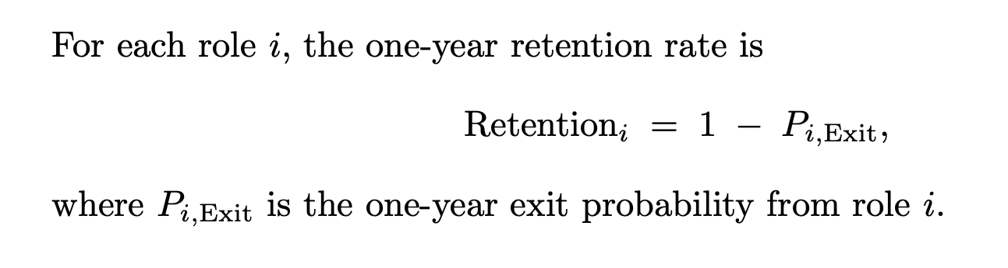
How We Count Who Stays
Notes:
I think you got my point.,.
Here’s the simple formula we use to turn exit rates into retention rates.”
Retention Rate for a role = 1 - the exit probability
If 27% of paraprofessionals exit in a year, then Retention = 1 – 0.27 = 0.73, or 73% stay.
Likewise, if 8% of teachers exit, then 1 – 0.08 = 0.92, or 92% remain.
With those retention rates in hand, we can now reverse our perspective and plot retention curves—showing the chance of still being in each role over time. Let’s take a look at those next.

Slide 22
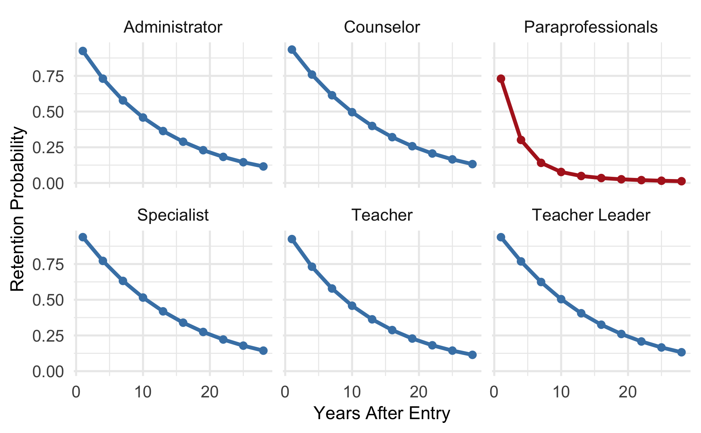
Who Sticks Around? Retention Curves for Each Role
Notes:
These six charts show, for each role, the chance of still being in that job over the years after you start.
– Paraprofessionals (red line) plunge toward zero by year 10, reflecting their high annual exit rate.
– All other roles (blue lines) decline much more slowly
—around half remain in the same role even after ten years.
This stark contrast underscores how uniquely vulnerable paraprofessionals are—and why boosting their retention would make the biggest difference.
so next i gonna generate markov chains simulations on What‐If Scenario – Boosting Retention by 20%

Slide 23
Policy Simulation Setting Up a 20% Retention Boost

Slide 24
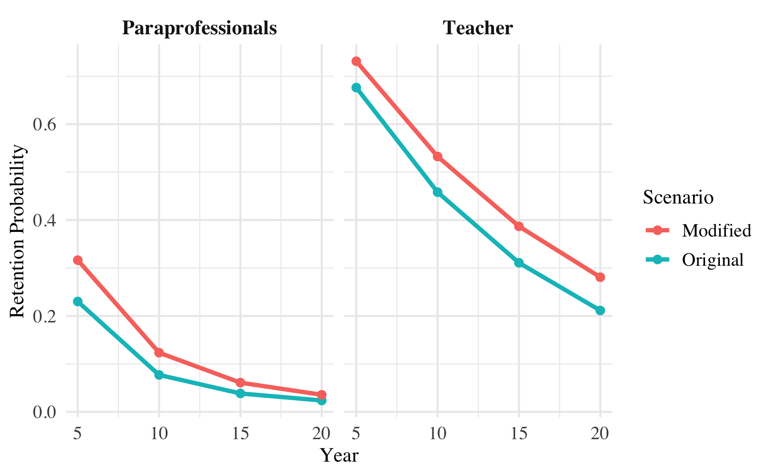
Powering Up Retention by 20%: A Before & After
Notes:
Let’s imagine we could improve each role’s one‐year retention rate by 20% (for example, raising Teacher from 71% to 85%). We’ll rerun our Markov model with these enhanced retention rates to see how long‐run role distributions shift.
How We Adjust Exit Rates:
New Exit Rate = Original Exit × (1 – 0.20)
This translates to a 20% relative reduction in turnover across every role.
Why This Matters:
Even a modest cut in exit probabilities can have an outsized impact on long‐term staffing, especially for high‐churn roles like paraprofessionals.
Next, we’ll compare the original and improved steady‐state distributions side by side to see exactly how many more educators stay in the system—and in the classroom.
On these two charts, the blue lines show our original retention curves, while the red lines show what happens if we boost one‐year retention by 20%.
– For paraprofessionals, moving from about 23% retained at year 5 up to roughly 32% is a dramatic lift—more than a third higher. – For teachers, the improvement is steadier but still important: for example, year 10 retention rises from about 45% to 55%.
“This ‘what-if’ clearly demonstrates that even a modest retention gain can translate into many more educators staying in their roles over the long term—especially in our highest-churn positions.

Slide 25
Thank You!
Notes:
That ‘what-if’ scenario shows just how powerful even small retention gains can be for our school workforce. I’m grateful to my advisor, Dr. Mahbubul Majumder, and committee members, Dr. Xiaoyue Cheng and Dr. Tami Williams, for their guidance on this project. Thanks also to my wife , son and friends for their support throughout. I appreciate your attention today and would be happy to take any questions.

